Slide 1
SQL Server Query Tuning
Module 9

Slide 3
Learning Units covered in this Module
Lesson 1: SARGable Expressions
Lesson 2: Extended Events

Slide 4
Lesson 1: Sargable Expressions

Slide 5

Objectives
After completing this learning, you will be able to:
Address SARGability Issues.
Use computed columns for performance.
Use constraints for performance.
Understand parameter sniffing.

Slide 6

SARGability
What is this?
A SARGable item in a search predicate is able to use an index.
Non-SARGable expressions can significantly slow down queries.
Notes:
In relational databases, a condition (or predicate) in a query is said to be sargable if the DBMS engine can take advantage of an index to speed up the execution of the query. The term is derived from a contraction of Search ARGument ABLE.
For further information refer to:
https://en.wikipedia.org/wiki/Sargable

Slide 7
Non-SARGable Expressions
Functions
WHERE ABS(ProductID) = 771
WHERE UPPER(City) = “London”
WHERE UPPER(surname) = “SMITHS”
Calculations / Expressions
WHERE Sales.Price + Sales.Tax > 100
WHERE Sales.Price * (1 + Sales.TaxRate) > 100
Using leading wildcard with LIKE operator
WHERE Employee.FirstName LIKE '%L%' is non-SARGable
WHERE Employee.FirstName LIKE ‘L%' is SARGable
Notes:
At compile time, the SQL Server Query Optimizer uses statistics and some internal transformation rules and heuristics to determine the best possible plan that it can use to run a query.
In this process, we have already seen that the WHERE clause is one of the first to be evaluated, and it is according to the estimated cost to resolve the search predicates that the Query Optimizer chooses to do seeks or scans over indexes, if available.
However, there are some rules, we must pay attention to influence the ability of the Optimizer to use histograms in order to do the estimations, and instead force that either density vectors are used, or even pre-determined estimations (like estimating 1 row for table variables), which are sometimes called magic densities.
Given this, here are a few indications of when an index cannot be used for a seek:
When some complex expressions are used as the search predicates, and these are unknown at compile time.
With expressions using functions. There are some exceptions to this, notably the CAST function in certain circumstances used with a date field. However, generally avoid functions that operate on a column if index usage is desired.
With inequalities in predicates.
With implicit conversions, as these are not known at compile time.
With LIKE expressions where the search condition starts with a wildcard character.

Slide 8
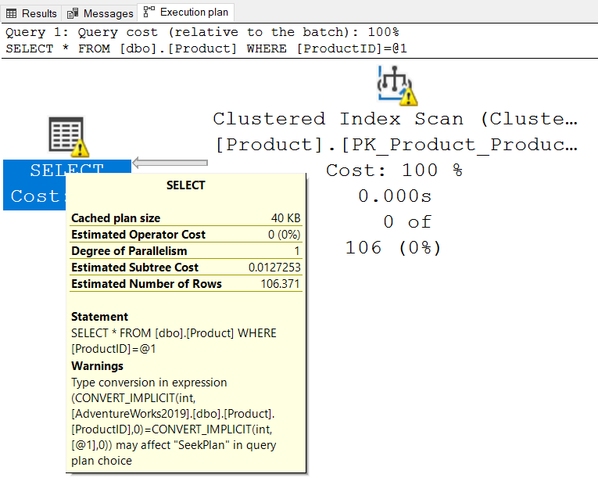
Non-SARGable Expressions
Continued
Implicit Conversions
ProductID is defined as nvarchar(8)
SELECT *
FROM [dbo].[Product]
WHERE [ProductID] = 7
SELECT *
FROM [dbo].[Product]
WHERE [ProductID] = N’7’
Notes:
For further information refer to:
https://techcommunity.microsoft.com/t5/sql-server/when-do-conversions-generate-conversion-warnings-and-why-are/ba-p/384356

Slide 9
Using Computed Columns to Improve Performance
Resolving non-SARGable expressions
Create computed column to Replace calculations / expressions.
Create an index on computed column.
Selectivity issues for inequalities
SQL Server assumes 30% selectivity on inequality comparisons.
Computed column will have more accurate statistics.
No need to specify computed column.
Notes:
A computed column is computed from an expression that can use other columns in the same table. The expression can be a noncomputed column name, constant, function, and any combination of these connected by one or more operators. The expression cannot be a subquery.
For example, in the AdventureWorks2008R2 sample database, the TotalDue column of the Sales.SalesOrderHeader table has the definition: TotalDue AS Subtotal + TaxAmt + Freight.
Unless otherwise specified, computed columns are virtual columns that are not physically stored in the table. Their values are recalculated every time they are referenced in a query. The Database Engine uses the PERSISTED keyword in the CREATE TABLE and ALTER TABLE statements to physically store computed columns in the table.
Computed columns can be used in select lists, WHERE clauses, ORDER BY clauses, or any other locations in which regular expressions can be used, with the following exceptions:
Computed columns used as CHECK, FOREIGN KEY, or NOT NULL constraints must be marked PERSISTED. A computed column can be used as a key column in an index or as part of any PRIMARY KEY or UNIQUE constraint if the computed column value is defined by a deterministic expression and the data type of the result is allowed in index columns.
For example, if the table has integer columns a and b, the computed column a + b can be indexed, but computed column a + DATEPART(dd, GETDATE()) cannot be indexed because the value may change in subsequent invocations.
A computed column cannot be the target of an INSERT or UPDATE statement.
For further information refer to:
https://docs.microsoft.com/en-us/previous-versions/sql/sql-server-2008-r2/ms191250(v=sql.105)?redirectedfrom=MSDN

Slide 10
Using Computed Columns to Improve Performance
Persisted Computed Columns
Specifies that the Database Engine will physically store the computed values in the table.
Marking a computed column as PERSISTED allows an index to be created on a computed column that is deterministic.
--Add a new computed column as persisted
ALTER TABLE [dbo].[ProductTest]
ADD stockValue AS (isnull(([UnitPrice] * ((1.0) - [UnitPriceDiscount])) * [StockQty], (0.0))) PERSISTED;
--Create an index on new computed column to improve query performance
CREATE INDEX IX_StockValue ON [dbo].[ProductTest](stockValue);
Notes:
PERSISTED
Specifies that the Database Engine will physically store the computed values in the table, and update the values when any other columns on which the computed column depends are updated. Marking a computed column as PERSISTED allows an index to be created on a computed column that is deterministic, but not precise. For more information, see Indexes on Computed Columns. Any computed columns used as partitioning columns of a partitioned table must be explicitly marked PERSISTED. computed_column_expression must be deterministic when PERSISTED is specified.
Creating Indexes on Persisted Computed Columns
Sometimes you can create a computed column that is defined with an expression that is deterministic yet imprecise. You can do this when the column is marked PERSISTED in the CREATE TABLE or ALTER TABLE statement.
This means that the Database Engine stores the computed values in the table, and updates them when any other columns on which the computed column depends are updated. The Database Engine uses these persisted values when it creates an index on the column, and when the index is referenced in a query.
This option enables you to create an index on a computed column when Database Engine cannot prove with accuracy whether a function that returns computed column expressions, particularly a CLR function that is created in the .NET Framework, is both deterministic and precise.

Slide 11
Using Constraints to Improve Performance
Helping Query Optimizer to choose better plans
UNIQUE constraint
DISTINCT property can be ignored
Extra columns in ORDER BY may be ignored
CHECK constraint
CHECK constraints enforce domain integrity by limiting the values that are accepted by one or more columns.
Primary Key
Special case of UNIQUE constraint
Foreign Key
Declarative Referential Integrity (DRI)
Usually faster than triggers
Allows the query optimizer to identify unnecessary joins
Notes:
For further information refer to:
Primary and Foreign Key Constraints
https://docs.microsoft.com/en-us/sql/relational-databases/tables/primary-and-foreign-key-constraints?view=sql-server-ver15
Unique Constraints and Check Constraints
https://docs.microsoft.com/en-us/sql/relational-databases/tables/unique-constraints-and-check-constraints?view=sql-server-ver15

Slide 12
Parameter Sniffing
SQL Server "sniffs" current parameter values during compilation or recompilation.
Parameter values are passed along to Query Optimizer, generating a more efficient execution plan.
The generated plan stays in query cache.
Stored procedures
Queries submitted via sp_executesql
Prepared queries
Parameter sniffing can be seen on the following types of batches:
Notes:
Parameter Sniffing
"Parameter sniffing" refers to a process whereby SQL Server "sniffs" the current parameter values during compilation or recompilation, and passes it along to the Query Optimizer so that they can be used to generate potentially more efficient query execution plans.
Parameter values are sniffed during compilation or recompilation for the following types of batches:
Stored procedures
Queries submitted via sp_executesql
Prepared queries
For more information on troubleshooting bad parameter sniffing issues, see Troubleshoot queries with parameter-sensitive query execution plan issues.

Slide 13
Parameter Sniffing
Mitigation
RECOMPILE
This workaround trades compilation time and increased CPU for better plan quality.
OPTION (OPTIMIZE FOR…)
This option requires a good understanding of optimal parameter values and associated plan characteristics.
OPTION (OPTIMIZE FOR UNKNOWN)
Overrides the actual parameter value and instead use the density vector.
DISABLE_PARAMETER_SNIFFING
Disables parameter sniffing entirely. This hint name is equivalent to: - TRACE FLAG 4136
KEEPFIXEDPLAN
This workaround assumes that the good-enough common plan is the one in cache already.
USE PLAN
Force the plan by explicitly using this query hint by rewriting the query and adding the hint in the query text. Or set a specific plan by using Query Store.
- Database Scoped Configuration setting PARAMETER_SNIFFING = OFF
Notes:
Several workarounds can mitigate Parameter Sniffing problems. Each workaround has associated tradeoffs and drawbacks:
Use the RECOMPILE query hint at each query execution. This workaround trades compilation time and increased CPU for better plan quality. The RECOMPILE option is often not possible for workloads that require a high throughput.
Use the OPTION (OPTIMIZE FOR…) query hint to override the actual parameter value with a typical parameter value that produces a plan that's good enough for most parameter value possibilities. This option requires a good understanding of optimal parameter values and associated plan characteristics.
Use the OPTION (OPTIMIZE FOR UNKNOWN) query hint to override the actual parameter value and instead use the density vector average. You can also do this by capturing the incoming parameter values in local variables and then using the local variables within the predicates instead of using the parameters themselves. For this fix, the average density must be good enough.
Disable parameter sniffing entirely by using the DISABLE_PARAMETER_SNIFFING query hint.
Use the KEEPFIXEDPLAN query hint to prevent recompilations in cache. This workaround assumes that the good-enough common plan is the one in cache already. You can also disable automatic statistics updates to reduce the chances that the good plan will be evicted and a new bad plan will be compiled.
Force the plan by explicitly using the USE PLAN query hint by rewriting the query and adding the hint in the query text. Or set a specific plan by using Query Store or by enabling automatic tuning.
Replace the single procedure with a nested set of procedures that can each be used based on conditional logic and the associated parameter values.
Create dynamic string execution alternatives to a static procedure definition.
For further information refer to:
https://docs.microsoft.com/en-us/sql/t-sql/queries/hints-transact-sql-query?view=sql-server-ver15

Slide 14

Demonstration
Query Tuning Sargability
Query Tuning using
Sargability
Constraints
Computed Columns
Notes:
Previous demonstration files are under E:\Archived.
You can open all the demonstrations by using the solutions file :
E:\Demos\SQL_PTO_Workshop_Demos.ssmssln
Individual SQL demo file.
E:\Demos\09_Query_Tuning\SARGability.sql”

Slide 15

Query Tuning SARGability
Applying SARGable expression to create better execution plans
Notes:
M09L01Lab01
Lab: Query Tuning SARGability
In this lab, you will learn about SARGability.
Objectives
After completing this lab, you will be able to:
Help the optimizer to create better plans by using SARGable expressions.

Slide 16

Questions?

Slide 17
Knowledge Check
Give two examples of non-SARGable expressions.
Explain three hints we can use to mitigate Parameter Sniffing.
Notes:
Answer 1:
Give two examples of non-SARGable expressions. Some examples of non-SARGable expressions are:
Column wrapped in a function like YEAR(OrderDate)
Implicit conversions like VARCHAR column values to NVARCHAR
Where Employee.FirstName LIKE '%x%‘
Where Sales.Price + Sales.Tax > 100
Answer 2:
Explain three hints we can use to mitigate Parameter Sniffing issues
Recompile
OPTION (OPTIMIZE FOR UNKNOWN)
DISABLE_PARAMETER_SNIFFING

Slide 18
Lesson 2 : Extended Events

Slide 19
Objectives
After completing this learning, you will be able to:
Understand Extended Events objects.
Create and configure Extended Event Sessions.
Implement filtering, aggregation, and perform analysis via the UI in SSMS.
Use Extended Events Profiler (XEProfiler).

Slide 20
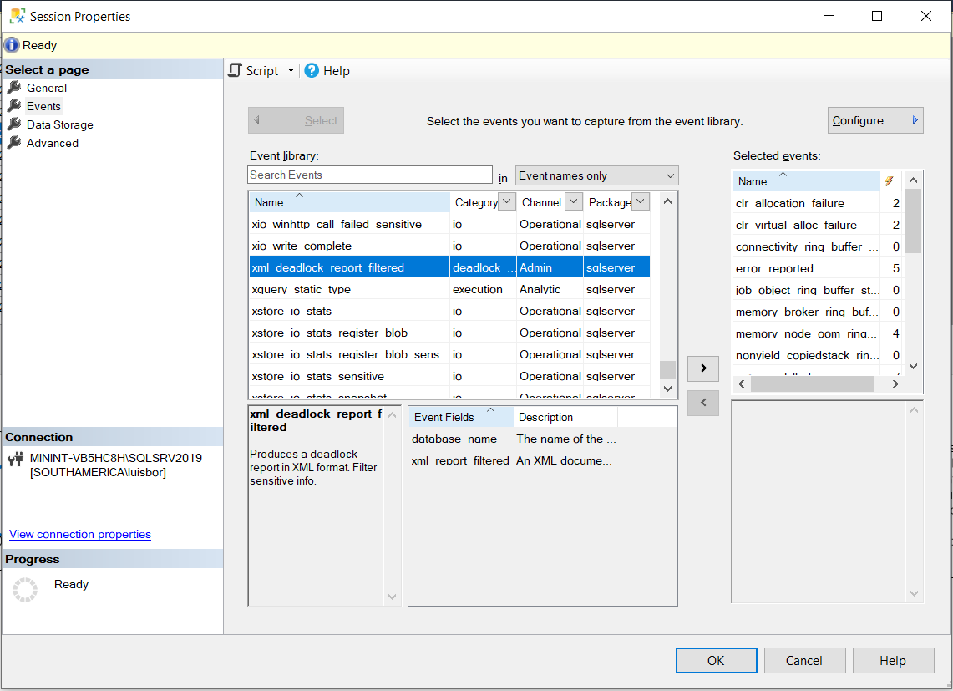
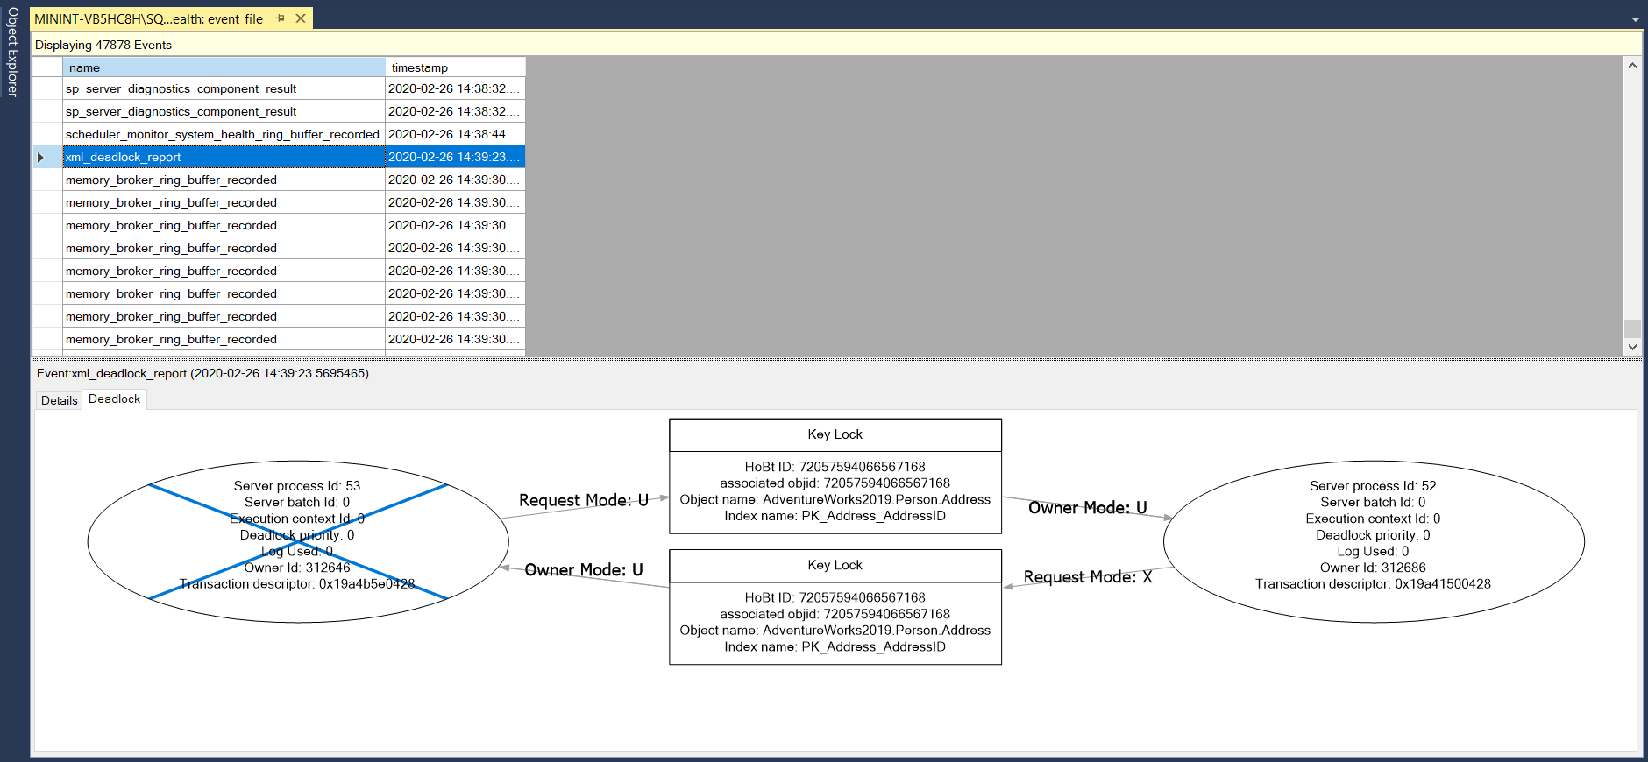
Troubleshooting Tools
Extended Events – System Health Session
The system_health session is an Extended Events session that is included by default with SQL Server.
This session starts automatically when the SQL Server Database Engine starts and runs without any noticeable performance effects.
The session collects system data that you can use to help troubleshoot performance issues in the Database Engine.
Never change this session definition – always create your own according to your requirements.
Notes:
For further information refer to:
https://docs.microsoft.com/en-us/sql/relational-databases/extended-events/use-the-system-health-session?view=sql-server-ver15
For information on the System_health session.
Use the system_health session - SQL Server | Microsoft Learn
Additional information on advanced filtering etc.
https://docs.microsoft.com/en-us/sql/relational-databases/extended-events/advanced-viewing-of-target-data-from-extended-events-in-sql-server?view=sql-server-ver15
Complete video series on Extended events
http://www.sqlbobt.com/for-your-dining-pleasure-the-first-sql-meals-is-now-being-served-2/

Slide 21
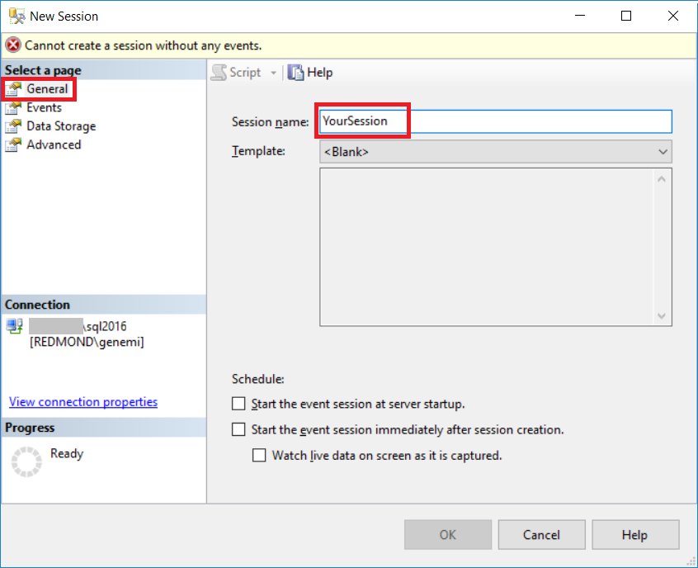
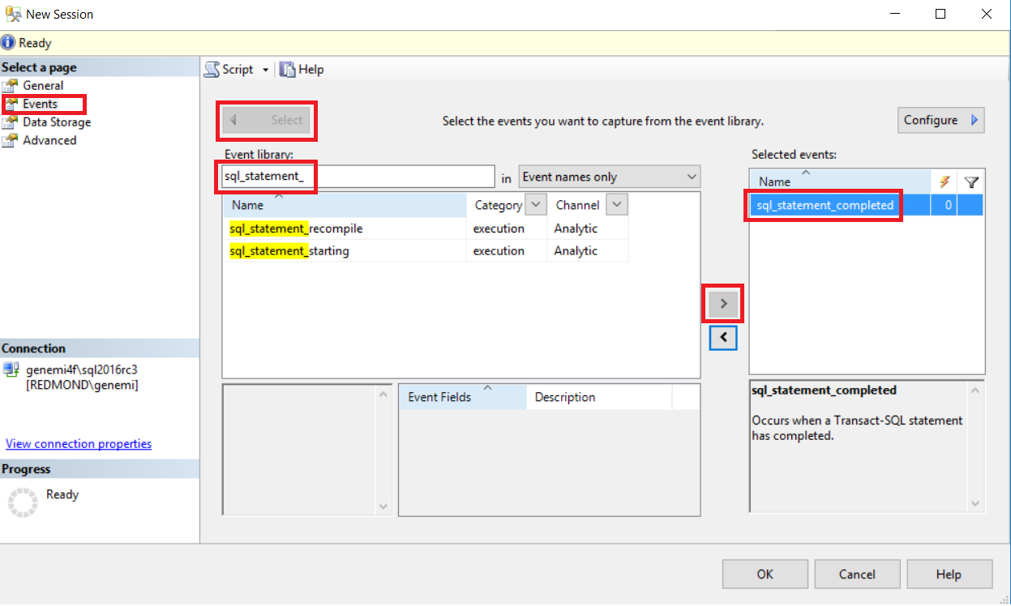
Extended Events in SSMS
Notes:
Good in-depth tutorial on Extended Events.
https://docs.microsoft.com/en-us/sql/relational-databases/extended-events/quick-start-extended-events-in-sql-server?view=sql-server-ver15
Create an event session in SSMS
When you create an Extended Events session, you tell the system:
Which events you're interested in
How you want the system to report the data to you
The demonstration opens the New Session dialog, shows how to use its four pages, named:
General
Events
Data Storage
Advanced
The text and supporting screenshots can be slightly different in your version of SSMS, but should still be relevant for the explanation of basic concepts.
Connect to a database engine instance. Extended Events are supported starting with SQL Server 2014, in Azure SQL Database, and Azure SQL Managed Instance.
In Object Explorer, select Management > Extended Events. In Azure SQL Database, event sessions are database-scoped, so the Extended Events option is found under each database, not under Management. Right-click on the Sessions folder and select New Session. The New Session dialog is preferable to New Session Wizard, although the two are similar.
In the upper-left, select the General page. Then type YourSession, or any name you like, into the Session name text box. Don't select OK yet, because you still need to enter some details on other pages.
4. In the upper-left, select the Events page.

Slide 22
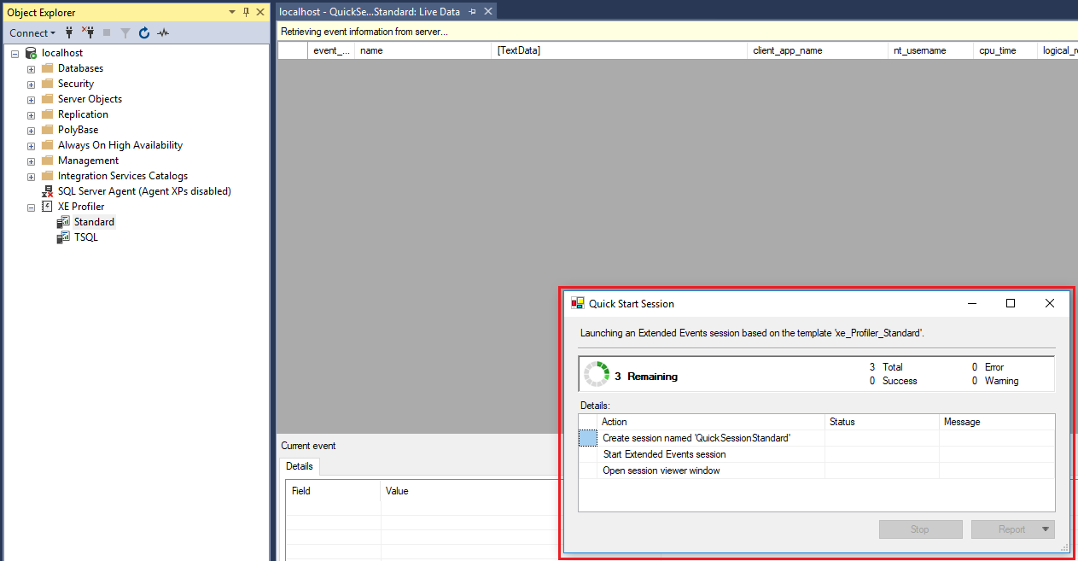
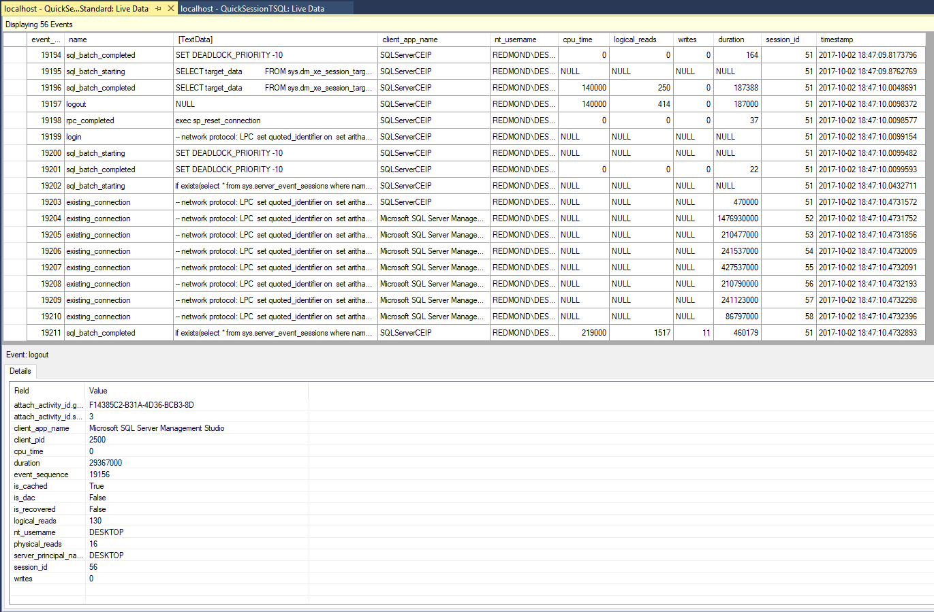
Extended Events Profiler
Notes:
Good in-depth tutorial on Extended Events Profiler
https://docs.microsoft.com/en-us/sql/relational-databases/extended-events/use-the-ssms-xe-profiler?view=sql-server-ver15
The XEvent Profiler is a SQL Server Management Studio (SSMS) feature that displays a live viewer window of Extended Events. This overview describes the reasons for using this profiler, key features, and instructions to get started viewing Extended Events.
Why would I use the XEvent Profiler?
Unlike SQL Profiler, XEvent profiler is directly integrated into SSMS and is built on top of the scalable Extended Events technology in the SQL engine. This feature enables quick access to a live streaming view of diagnostics events on the SQL Server. This view can be customized and those customizations can be shared with other SSMS users as a .viewsettings file. The session created by XE Profiler is less intrusive to the running SQL Server than a similar SQL trace would be when using SQL Profiler. This session can be customized by the user as well, using the existing XE session properties UI or by Transact-SQL.

Slide 23
Demonstration
SQL Server Management Studio Extended Events UI
XE Profiler
Notes:
Previous demonstration files are under E:\Archived.
You can open all the demonstrations by using the solutions file :
E:\Demos\SQL_PTO_Workshop_Demos.ssmssln
Individual SQL demo file.
E:\Demos\09_Query_Tuning\Extended Events\Extended Events Architecture.ssmssqlproj
DEMO SQL SERVER Management Studio Extended Event UI
Open the QuickSessionTSQL pre-defined session.
Show how to select and configure events, actions, and targets.
Be sure to show Channels and how Debug channel is not on by default!
Capture data – run any work load.
Select View Live Data.
Demonstrate creating and using view settings.
DEMO XE Profiler
Demonstrate the two XE Profiler pre-configured sessions.
Explain how they map to the two most used Profiler templates.
More information:
https://docs.microsoft.com/en-us/sql/relational-databases/extended-events/use-the-ssms-xe-profiler?view=sql-server-ver15

Slide 24
Extended Events
Examining Extended Event Functionality
Notes:
M10L02Lab01

Slide 25
Questions?

Slide 26
Knowledge Check
What are the Extended Event objects?
What is XEProfiler?
When additional data elements capture is need, how can it be configured?
Which channel is disabled by default when creating a session?
Notes:
Q1) What are the Extended Event objects?
A1) package, event, target, type, action, predicates, maps, and messages
Q2) What is XEProfiler?
A2) XEProfiler is a UI that was added to SSMS in version 17.3 that simplifies the use of extended events. It provides two predefined sessions that are equivalent to the most used Profiler templates.
Q3) When additional data elements capture is need, how can it be configured?
A3) You add Actions to Events
Q4) Which channel is disabled by default when creating a session?
A4) Debug Channel

